Slide 1
Cloud computing

Slide 2
Contents
Virtualisation
Datacentres
Cloud Computing drivers
Cloud Computing

Slide 3
Virtualisation
Virtualisation: creation of a virtual version (instead of actual) of something, abstracting from the real details
Hardware virtualisation consists of showing an abstract computing platform, hiding the physical characteristics of a computing platform from users.
The VMM (Virtual Machine Monitor) Ssoftware controls the virtual machines and mediates with the real hardware
5

Slide 4
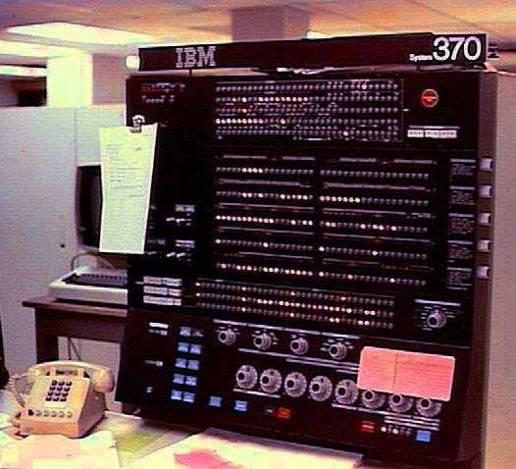
Origins of virtualisation
Computing is expensive!
Virtualisation began in the 1960s
Method of logically dividing the system resources provided by mainframe computers between different applications
Adapted from: Ken Birman
Notes:
Computing is Expensive!
Computing resources, such as hardware, electricity, cooling, and maintenance, have always been costly. In the early days, computers were massive, expensive machines that required significant investment. Organizations had to purchase mainframe computers to process large amounts of data, and maintaining them was costly due to high power consumption and specialized infrastructure.
Virtualization Began in the 1960s
To optimize the use of expensive mainframe computers, virtualization was introduced in the 1960s. The idea was to create multiple "virtual" machines on a single physical machine, allowing different applications to run simultaneously without interfering with each other.
IBM was a pioneer in this field, developing time-sharing systems that allowed multiple users to access computing power from a single mainframe. This improved efficiency and reduced costs by maximizing hardware utilization.
Method of Logically Dividing System Resources
Virtualization works by logically partitioning the system resources (CPU, memory, storage, and network) among different applications or users. Instead of running one application on one physical machine, multiple applications could share the same hardware without conflict.
This concept evolved into modern-day virtual machines (VMs) and cloud computing, where virtualization is a core technology. Today, virtualization enables cloud providers like AWS, Google Cloud, and Microsoft Azure to offer computing resources on demand, making computing more efficient and cost-effective

Slide 5

Origins of virtualisation
1970s: IBM VM/370 – A VMM for IBM mainframe
  Multiple users, OS environments on expensive hardware
  Desirable when few machines were around
Popular research idea in 1960s and 1970s
  Entire conferences on virtual machine monitors
  Hardware/VMM/OS designed together
Interest died out in the 1980s and 1990s
  Hardware got cheaper
  Operating systems got more powerful (e.g. multi-user)
Adapted from: Ken Birman
Notes:
IBM VM/370 – A Virtual Machine Monitor (VMM) for IBM Mainframes (1970s)
IBM introduced VM/370 in the 1970s, a Virtual Machine Monitor (VMM) that allowed multiple users to run different operating system environments on a single IBM mainframe.
This was highly beneficial because:
Mainframes were expensive – Running multiple OS environments on one machine improved resource utilization.
Few machines were available – Sharing computing power was necessary.
Virtualization as a Research Trend (1960s-1970s)
Virtualization was a popular research area during this time.
Entire conferences were dedicated to Virtual Machine Monitors (VMMs).
Hardware, VMMs, and operating systems were designed together to maximize efficiency.
Decline of Virtualization Interest (1980s-1990s)
Virtualization lost popularity due to:
Cheaper hardware – Organizations could afford multiple machines, reducing the need for sharing resources.
More powerful operating systems – OSs like UNIX and Windows NT introduced multi-user support, reducing reliance on virtual machines.
However, virtualization made a strong comeback in the 2000s with the rise of cloud computing, where virtualization became essential for resource efficiency

Slide 6
Virtualisation advantages
Better resource usage
  Processors, RAM and disk space are partitioned among multiple VMs
Performance isolation
  Each VM runs independently
Reduced impact of failures
  Failure in one VM does not affect the remaining elements

Slide 7
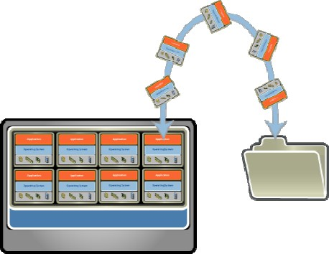
Virtual Machine images
VM images are handled as files
  Contains OS, applications, data
  Memory and device state
Enables VM migration and
replication
Preconfigured machines are distributed as virtual appliances
  Simplifies initial provisioning
Notes:
1. VM Images as Files
Virtual machines are stored as files (e.g., .vmdk, .qcow2, .vdi).
These files contain everything needed to run a VM, including:
Operating system (e.g., Linux, Windows).
Installed applications (e.g., databases, web servers).
User data (files, configurations).
Memory and device state (to resume execution).
2. Enables VM Migration and Replication
Since VM images are just files, they can be moved across different physical machines (migration).
VMs can be cloned to create identical copies (replication).
This is useful in cloud computing, backup, and load balancing.
3. Virtual Appliances for Easy Deployment
Preconfigured VMs are distributed as virtual appliances (e.g., .ova or .ovf files).
These come with pre-installed software and settings for quick deployment.
Simplifies initial provisioning, reducing setup time and configuration errors

Slide 8
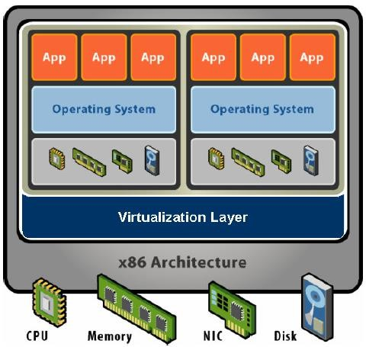
VMM Architecture
Software Abstraction
  Behaves like hardware
  Encapsulates all OS and application state
Virtualisation Layer
  Extra level of indirection
  Decouples hardware, OS
  Enforces isolation
  Multiplexes physical hardware across VMs
Example of VMMs
Type 1 (Bare-metal): Runs directly on hardware (e.g., VMware ESXi, Microsoft Hyper-V, Xen).
Type 2 (Hosted): Runs on top of an OS (e.g., VirtualBox, VMware Workstation).
Notes:
1. Software Abstraction
The VMM behaves like hardware, presenting a virtualized environment to each VM.
It encapsulates all the OS and application state, meaning each VM is independent of the others.
VMs believe they are running on real hardware, even though they share physical resources.
2. Virtualization Layer
Acts as an extra level of indirection between the physical hardware and VMs.
Decouples hardware from the OS, allowing different OS versions to run on the same machine.
Enforces isolation, ensuring that one VM cannot directly interfere with another.
3. Multiplexing Physical Hardware
The VMM shares CPU, memory, and I/O devices across multiple VMs.
It dynamically allocates resources based on demand.
Ensures efficient load balancing and fault tolerance in cloud environments.

Slide 9
Virtualisation Performance
Performance depends on the virtualisation technique
Emulation mimics as faithfully as possible the hardware platform of the guest VM
  Required for virtualizing different architectures
  Huge performance cost
Paravirtualisation modifies the guest VM so that it is aware of its virtualisation status
Hardware-assisted virtualisation provides near-optimum performance to guest VMs of the same physical architecture
  Intel VT-x, VT-d instruction sets
Notes:
Performance in Virtualization: Techniques and Impact
Virtualization performance is influenced by the virtualization technique used. Different methods impact speed, efficiency, and hardware compatibility.
1. Emulation
🔹 How it Works: The Virtual Machine Monitor (VMM) fully mimics a different hardware architecture for the guest VM.
🔹 Use Case: Running software designed for one CPU architecture (e.g., x86) on another (e.g., ARM).
🔹 Performance Impact:
✅ Highly flexible (can run any OS on any hardware).
❌ Very slow due to real-time instruction translation.
🔹 Example: QEMU without hardware acceleration.
2. Paravirtualization
🔹 How it Works: The guest OS is modified to be aware that it is running in a virtualized environment. Instead of trapping privileged instructions, it communicates directly with the hypervisor.
🔹 Use Case: High-performance virtualization where OS modification is possible.
🔹 Performance Impact:
✅ Much faster than emulation since there's no need for full hardware simulation.
❌ Guest OS needs modification (not all OS support it).
🔹 Example: Xen with Linux guests.
3. Hardware-Assisted Virtualization
🔹 How it Works: Uses CPU extensions like Intel VT-x and AMD-V to let guest OS run at near-native speed with direct access to some hardware functions.
🔹 Use Case: Running unmodified guest OS efficiently on modern processors.
🔹 Performance Impact:
✅ Almost native speed performance.
✅ No need to modify the guest OS (unlike paravirtualization).
🔹 Example:
VMware Workstation, VirtualBox, KVM using Intel VT-x or AMD-V.
VT-d (Intel) and AMD-Vi (AMD) extend this for direct I/O access.
Comparison Table: Virtualization Techniques
Technique OS ModificationSpeed Use Case
Emulation No ❌ Slow Running different architectures (e.g., ARM on x86)
ParavirtualizationYes⚡ FastCustom high-performance VMs
Hardware-AssistedNo⚡ FastModern hypervisors for general virtualization

Slide 10
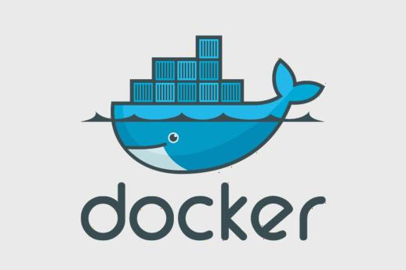
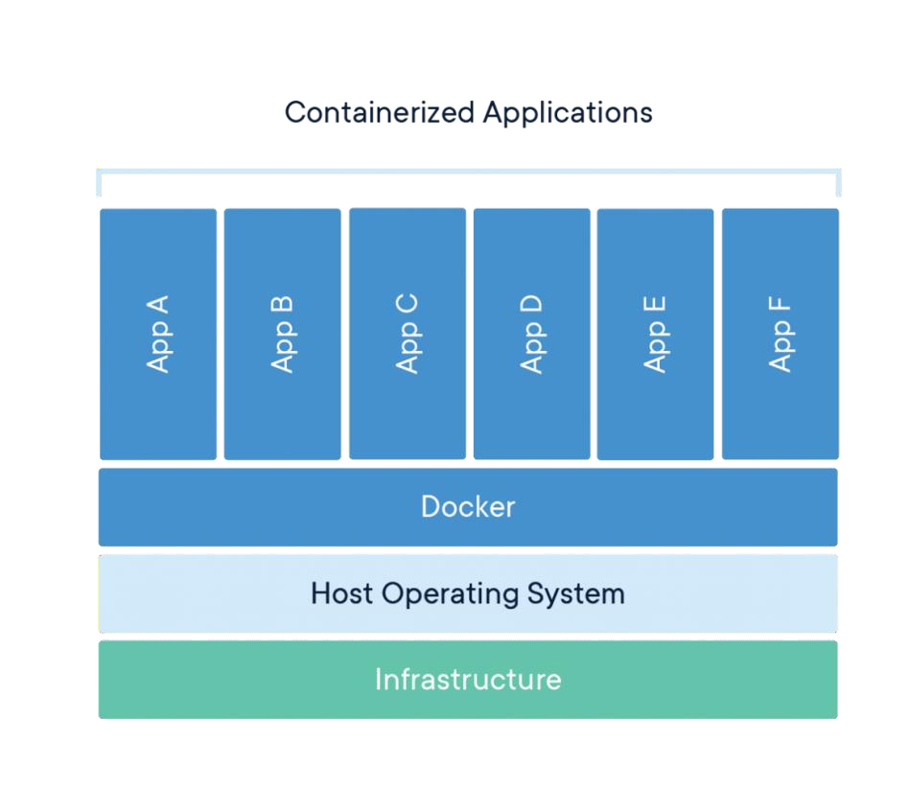
Virtual Containers
Lightweight virtualisation model
Operating System-level virtualisation
  Images only contain libraries and application code
“User space”
  Allocation of resources to container
Faster start-up
Easy replication
Worse isolation
Notes:
Container virtualization is a lightweight virtualization model that enables running multiple isolated applications on a shared operating system (OS). Unlike traditional virtual machines (VMs), containers do not include a full OS but instead share the host OS kernel while maintaining separate user spaces.
Key Features of Container Virtualization
1. Lightweight Virtualization Model
✅ Containers share the same OS kernel, making them more lightweight than full VMs.
✅ Instead of virtualizing hardware, it virtualizes only the user space of an application.
2. OS-Level Virtualization
✅ Containers run on top of a single host OS rather than requiring separate OS instances like VMs.
✅ The OS manages and isolates multiple containers efficiently.
3. Images Only Contain Libraries and Application Code
✅ Unlike VMs, containers do not package a full OS, only the necessary dependencies (libraries, binaries, application code).
✅ This results in smaller images and faster deployment.
4. "User Space"
✅ Each container has its own isolated user space but shares the same kernel with other containers on the host system.
5. Resource Allocation to Containers
✅ Containers can have specific CPU, memory, and storage limits assigned to them.
✅ The OS manages resource allocation dynamically.
6. Faster Start-Up
✅ Containers start in seconds, unlike VMs that require booting a full OS.
✅ This makes them ideal for microservices and cloud-native applications.
7. Easy Replication
✅ Containers allow for quick duplication and deployment of applications across different environments.
✅ This makes them useful in DevOps, CI/CD pipelines, and scaling applications.
8. Worse Isolation Compared to VMs
❌ Since containers share the same OS kernel, they are less isolated than VMs.
❌ A security vulnerability in the host OS can affect all containers running on it.
❌ Unlike VMs, containers do not have their own dedicated OS kernel, so an attacker may exploit kernel vulnerabilities.

Slide 11

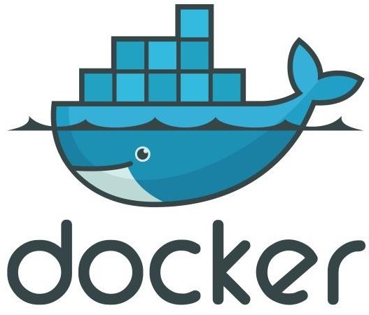

Traditional virtualisation vs Virtual Containers
App | App | App | App | App
Guest OS
VMM
VMM
Host OS
Host OS
Host infrastructure
Host infrastructure
Traditional virtualisation
Virtual containers
Notes:
Virtualization is a method of running multiple isolated environments on the same hardware. However, there are two main types of virtualization: Traditional Virtualization (VMs) and Container Virtualization.
1. Traditional Virtualization (VMs)
🔹 Uses Hypervisors (VMMs) like VMware, VirtualBox, KVM, or Hyper-V.
🔹 Each VM runs a full OS, including its own kernel, drivers, and system files.
🔹 Requires hardware emulation, which increases overhead.
🔹 VMs provide strong isolation but consume more resources.
🔹 Each VM can run a different OS (e.g., Linux on Windows).
🔹 Slower startup time due to full OS booting.
Example: Running multiple OS environments (Windows, Linux) on a single physical machine.
Architecture of Traditional Virtualization
lua
CopyEdit
-------------------------------- | Physical Hardware | |------------------------------| | Hypervisor (VMM) | |------------------------------| | VM 1 | VM 2 | VM 3 | | OS 1 | OS 2 | OS 3 | --------------------------------
2. Virtual Containers
🔹 Uses OS-level virtualization (e.g., Docker, LXC, Podman).
🔹 Containers share the same OS kernel, making them lightweight.
🔹 No full OS per container, only app-specific libraries and dependencies.
🔹 Faster startup as there’s no OS boot process.
🔹 Better performance since there's no hardware emulation.
🔹 Weaker isolation than VMs (since all containers share the host kernel).
🔹 Containers are portable and scalable, making them ideal for microservices and cloud applications.
Example: Running multiple isolated applications (e.g., Nginx, MySQL, Redis) on a single OS.
Architecture of Container Virtualization
lua
CopyEdit
-------------------------------- | Physical Hardware | |------------------------------| | Host OS | |------------------------------| | Container Engine (Docker) | |------------------------------| | App 1 | App 2 | App 3 | | Libs | Libs | Libs | --------------------------------

Slide 12
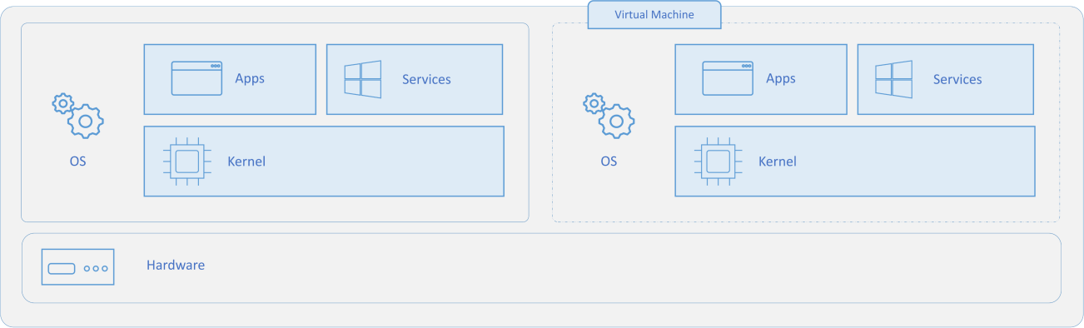
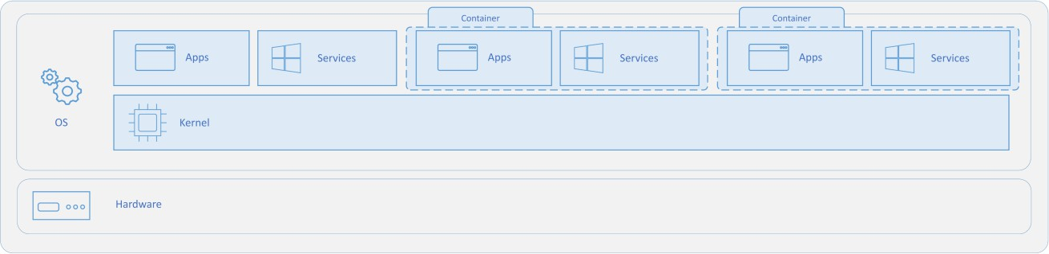
Virtual Containers vs virtual machines
Primary difference:
  VMs: complete operating system including the kernel
Containers: Runs the user mode portion of an operating system.
Source: https://docs.microsoft.com/en-us/virtualisation/windowscontainers/about/containers-vs-vm

Slide 13
Contents
Virtualisation
Datacentres
Cloud Computing drivers
Cloud Computing

Slide 14
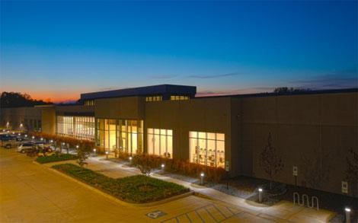
What’s a Datacentre?
Apple’s 500k square foot “iDataCenter”.
Source: http://www.datacenterknowledge.com/leed-platinum-data-centers
16

Slide 15
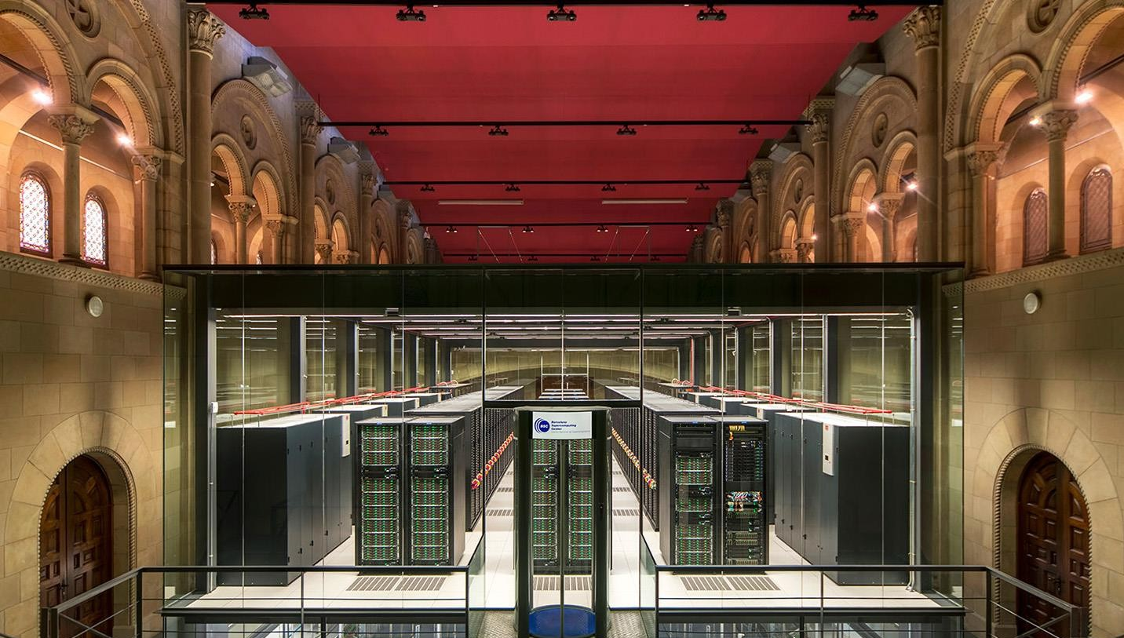
Barcelona Supercomputing Center

Slide 16
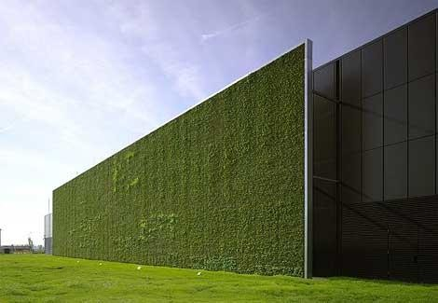
Datacentres
The 230,000 square foot Citigroup Frankfurt facility datacenter
Source: http://www.datacenterknowledge.com/leed-platinum-data-centers
18

Slide 17
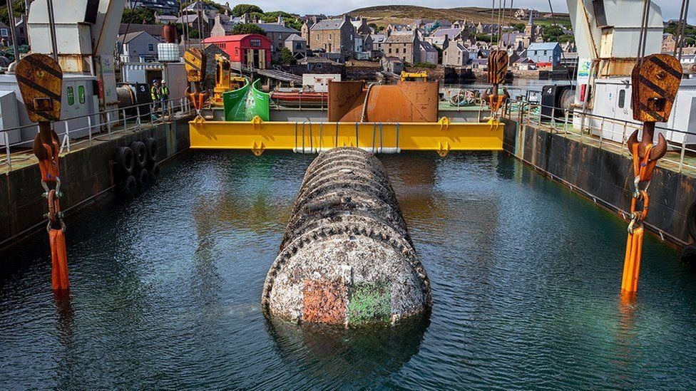
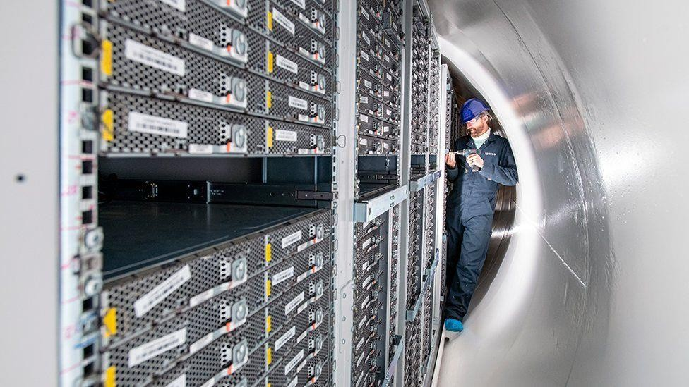
Datacentres
Microsoft's underwater data centre
Source: https://www.bbc.co.uk/news/technology-54146718

Slide 18
Datacentres
Datacentres are buildings where multiple servers and communication equipment are colocated because of their common environmental requirements and physical security needs
  Computing power
  Storage capabilities
  Network connectivity
WSC (Warehouse-Scale Computing): Datacentre that runs a small number of very large applications or services
  E.g. facebook, Twitter, Google Maps..

Slide 19
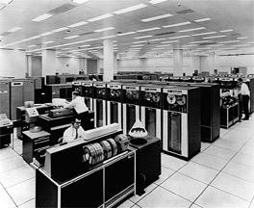
Datacenter architecture: is it something new?
Similar to IBM mainframes from the 70s but...
Huge scale (20K switches/routers)
High bandwidth (10/40/100G)
Very low Round trip Time (1-10 microseconds)
Limited geographic scope
Limited heterogeneity
Regular/planned topologies

Slide 20
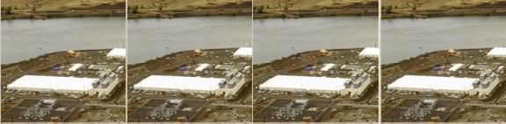
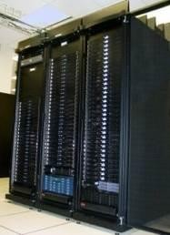
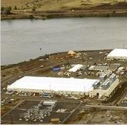
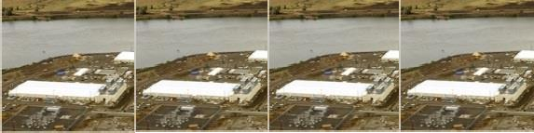
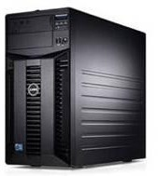
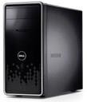
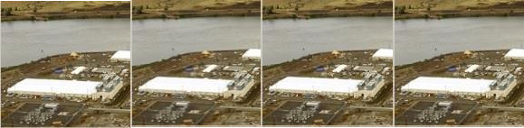
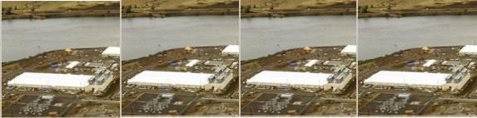
What if a Datacenter is not enough?
PC
Server
Cluster
Datacenter
More datacenters! a network of datacenters!

Slide 21
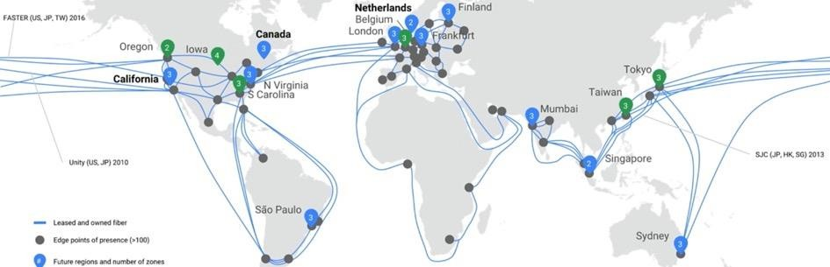
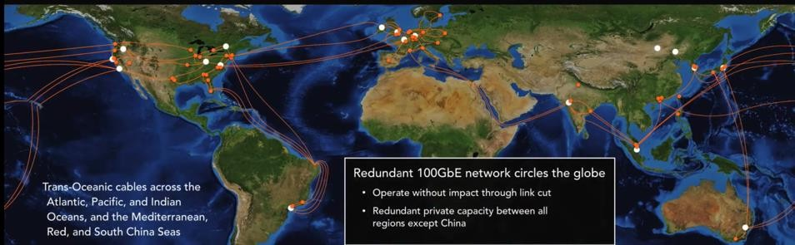
Datacenters are geographically distributed
Google Cloud backbone
AWS Amazon
backbone
23

Slide 22

Datacenter architecture

Slide 23

Datacenter architecture

Slide 24
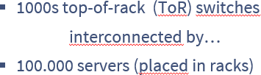
Datacenter architecture

Slide 25
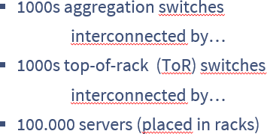
Datacenter architecture

Slide 26
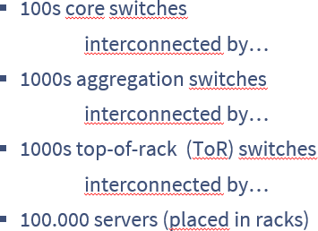
Datacenter architecture

Slide 27
Datacenter architecture

Slide 28
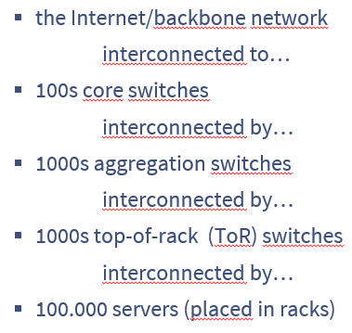
Datacenter architecture
Internet
the Internet/backbone network interconnected to…
100s core switches
interconnected by…
1000s aggregation switches
interconnected by…
1000s top-of-rack (ToR) switches interconnected by…
100.000 servers (placed in racks)

Slide 29
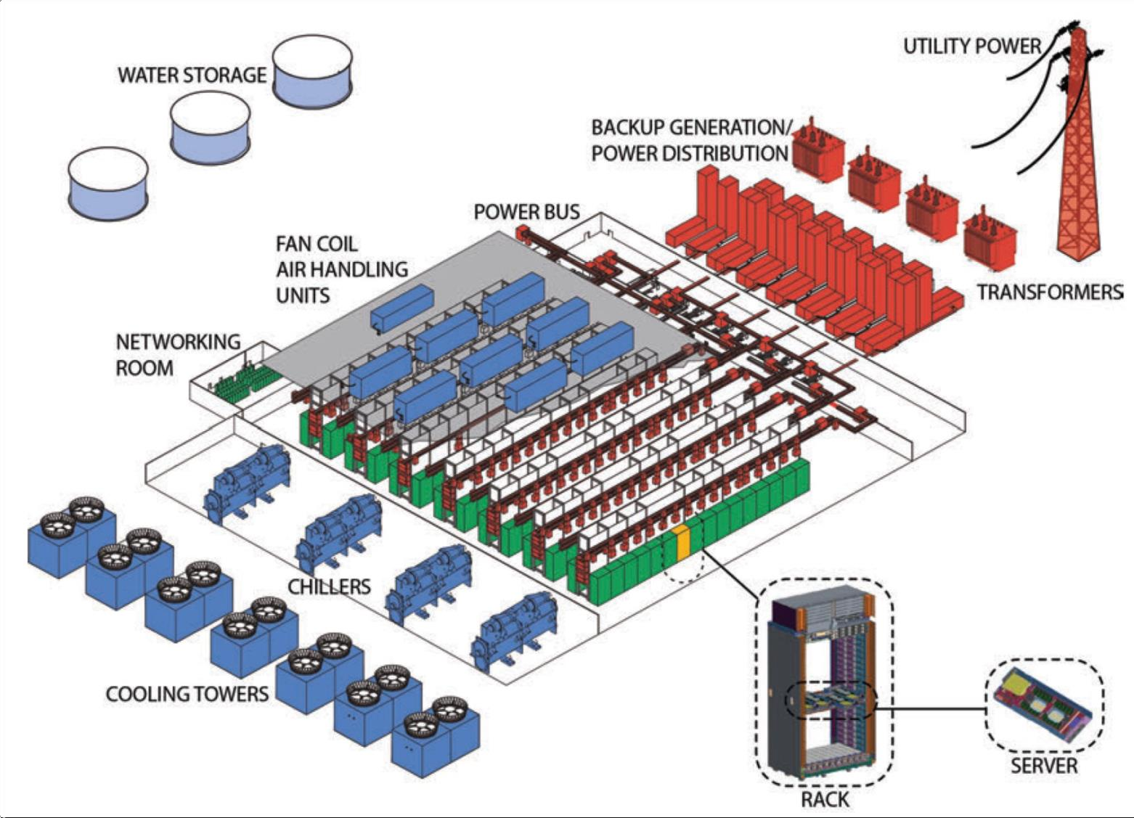
Datacentre Physical Architecture
Source: Datacenter as a Computer, 3rd Ed
33

Slide 30
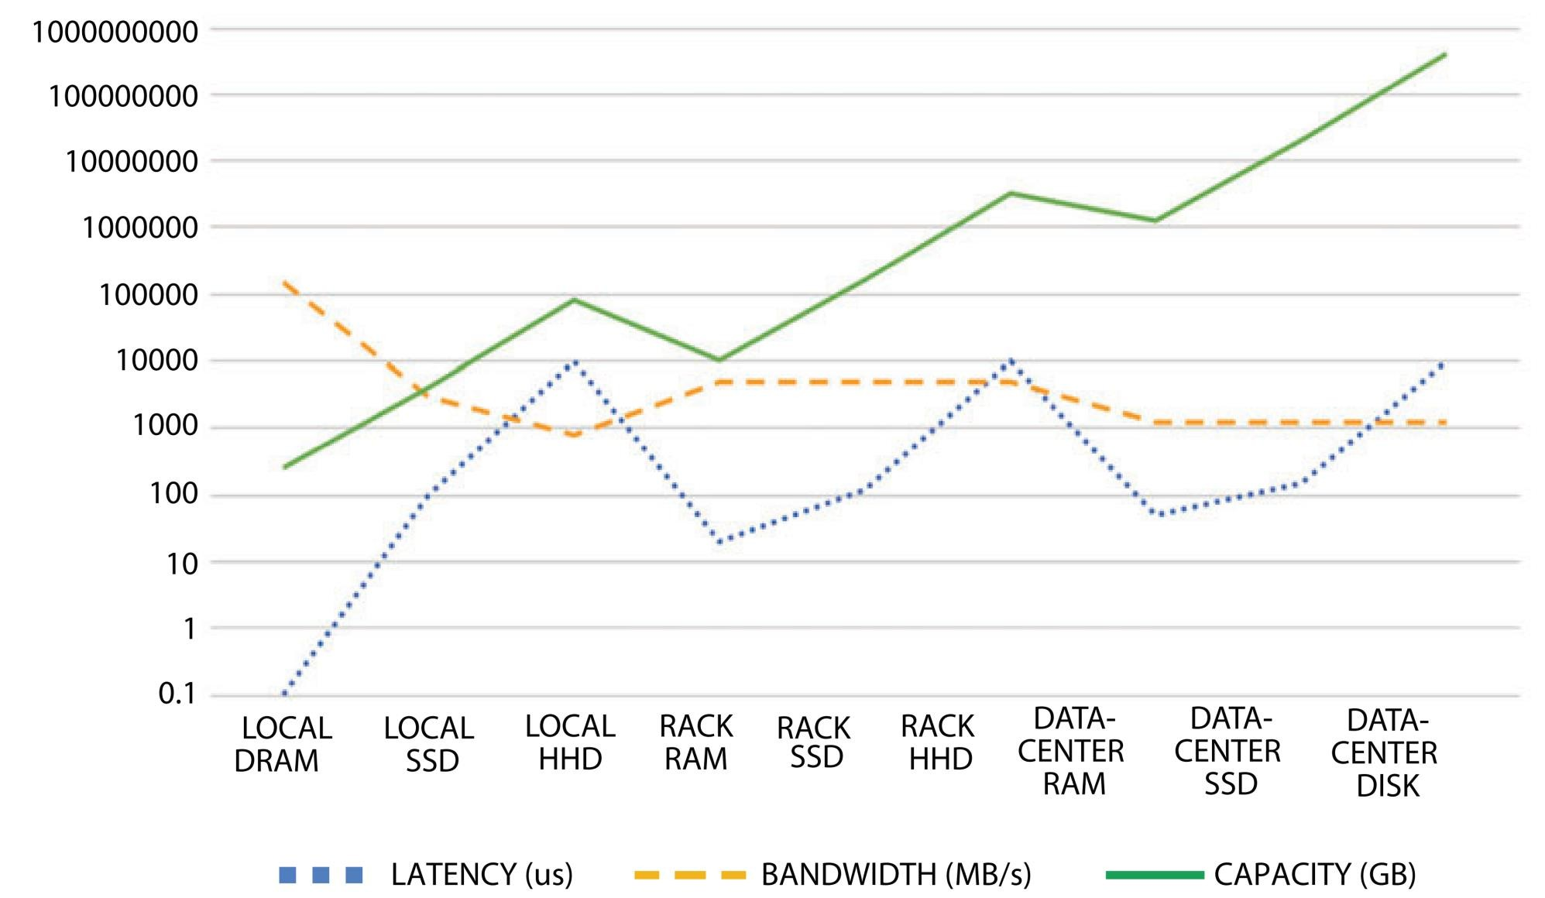
Datacentre shared resources
Relative latency/bandwidth/capacity
of each resource pool

Slide 31
Datacentre Design Requirements
Datacentres typically run two types of applications
  outward facing (e.g., serving web pages to users)
  internal computations (e.g., MapReduce for web indexing)
Workloads often unpredictable:
  Multiple services run concurrently within a DC
  Demand for new services may unexpectedly spike
Failures of servers are the norm
  WSC applications (MapReduce, NoSQL, etc.) resort to dynamic re-assignment of chunks to deal with failures
  Data is often replicated
  “Traffic matrix” between servers constantly changing

Slide 32
Datacentre Costs
Total cost varies
  upwards of $1/4 B for mega data center
  server costs dominate
  network costs significant
Long provisioning timescales:
  new servers purchased quarterly at best
Amortized Cost* | Component | Sub-Components
~45% | Servers | CPU, memory, disk
~25% | Power infrastructure | UPS, cooling, power distribution
~15% | Power draw | Electrical utility costs
~15% | Network | Switches, links, transit
*3 yr amortization for servers, 15 yr for infrastructure; 5% cost of money
Source: the Cost of a Cloud: Research Problems in Data Center Networks. Sigcomm CCR 2009.
11

Slide 33
Contents
Virtualisation
Datacentres
Cloud Computing drivers
Cloud Computing

Slide 34
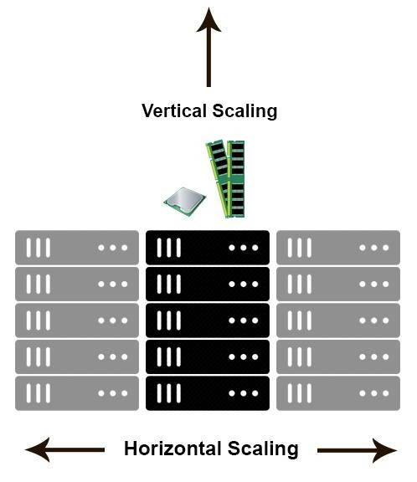
Scalability
Ability of a system, network, or process, to handle growing amount of work in a capable manner or its ability to be enlarged to accommodate that growth
  Vertical scaling: Upgrade machine capabilities (RAM, processor,…). Aka scale up
  Horizontal scaling: Replicate the functions in additional machines spreading the load among them. Aka scale out

Slide 35
Utility Computing
“Computing may someday be organized as a public utility”
- John McCarthy, MIT Centennial in 1961
Instead of purchasing the computing equipment, it is rented to a provider
  A provider hosts large datacenter
Metered billing (pay for what you use)
Simple to use interface to access the capability (e.g., plugging into an outlet)
From fixed costs to variable costs

Slide 36
Cloud Computing
Cloud computing is a model for enabling convenient, on- demand network access to a shared pool of configurable computing resources (e.g., networks, servers, storage, applications, and services) that can be rapidly provisioned and released with minimal management effort or service provider interaction.
NIST, 2011

Slide 37
Essential Cloud Characteristics
Pervasive network access
  Location independence
High availability
Resource pooling and partitioning
  Extensive use of virtualisation
Automated management for cloud clients
Rapid elasticity

Slide 38

Cloud driver: cost saving, capacity planning
 | Colocation | Managed | Cloud
Time | Weeks to Months | Days to Weeks | Minutes
Scalability | Slowest, Rigid & Costly | Slower, somewhat flexible, Costly | Instant, Flexible, Pay-per-usage
Cost | High CapEx | Costly, sometimes month/year contracts, no CapEx | No contracts, usage based, no upfront costs
Pricing model | Buy Servers & Colo costs whether used or not | Rent Servers & Hosting costs whether used or not | Rent based on usage only

Slide 39
Cloud driver: agility
Elasticity consists of changing dynamically the capabilities of an existing cloud resource
Elasticity allows cloud resources to easily adapt to changes in the requirements / expected load
  supporting a Mobile App, as no of clients increases
  increasing capacity of livescore service on Sundays
Two main elasticity techniques
  Migration to a different profile of VM
  Replication and load balancing among multiple

Slide 40
Elasticity: Shifting the Risk
One of the main economic appeals can be described as “converting capital expenses to operating expenses” but this can be simplified by think of it as a “pay as you go” model
Hours purchased via Cloud Computing can be distributed non-uniformly in time (e.g. use 100 server-hours today and no server-hours tomorrow and still only pay for what you use)

Slide 41
Elasticity: Shifting the Risk
In bandwidth terms this now as usage- based pricing
There is no up-front capital expense
Elasticity is Cloud Computing’s ability to add or remove resources at a fine grain (usually one server at a time) with a lead time of minutes rather than weeks

Slide 42
Elasticity: Shifting the Risk
This allows the matching of resources to workloads much more closely
Server utilisation in data centres ranges from 5% to 20%
In general peak workloads exceeds the average by factors of 2 to 10 so this is consistent with utilisation levels

Slide 43
Elasticity: Shifting the Risk
The key advantage of elasticity is that it reduces the risk of overprovisioning (underutilisation) and underprovisioning (saturation)
Most users deliberately provision for the expected peak and allow resources to remain idle at non peak times
The more pronounced the variation the greater the waste

Slide 44
Elasticity: Shifting the Risk
Consider the following example which shows how elasticity can reduce waste and thus, more than compensate for the potentially higher cost per server-hour of pay as you go vs buying
A service has predictable daily demand where the peak require 500 servers at noon but the trough requires only 100 servers at midnight

Slide 45
Elasticity: Shifting the Risk
If we shift to a cloud service which matches the server number to the demand we can reduce server costs by 40% (7200/12000 * 100 = 60%)
Peak: 500 servers * 24 hours = 12000 server-hours,
Average: 300 servers * 24 hours = 7200 server-hours
As long as the pay as you go cost per server hour over the amortization period (3 years is typical) we can save money using cloud computing

Slide 46
Elasticity: Shifting the Risk
These examples actually underestimate the benefits of cloud computing
In addition to diurnal patterns most nontrivial service also experience seasonal or other periodic demands which need to be incorporated into the analysis

Slide 47
Elasticity: Shifting the Risk
For example Ebay experiences greater traffic in December
Additionally, there can be unexpected demand bursts due to external events (news events) which need to be provisioned for when buying hardware
It is much easier to adjust for these events with cloud computing

Slide 48
Transference of Risk
It is frequently difficult to predict peak utilisation
While it is more difficult to predict the monetary effects of underprovisioning they are as just serious as the effects of overprovisioning
Rejected user generate zero revenue and may not come back due to poor service

Slide 49
Transference of Risk
When Animoto made its service available via Facebook it experienced a demand surge that resulted in growing from 50 servers to 3500 servers in three days
No one could have foreseen that resource needs would suddenly double every 12 hours for 3 days
In cases like these elasticity is not a cost optimisation but an operational requirement

Slide 50
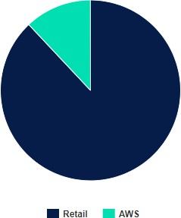
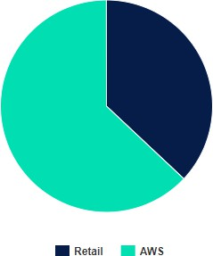
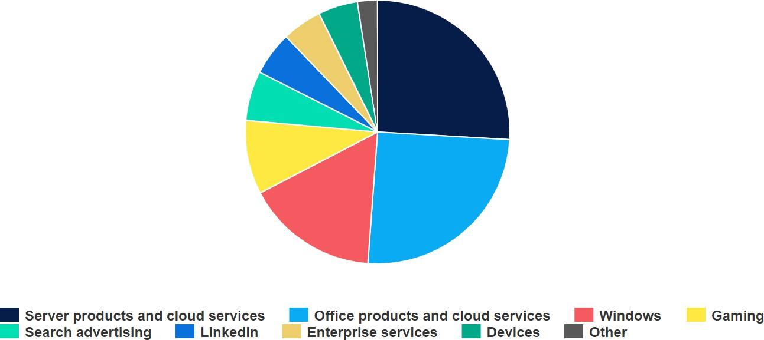
The cloud is a money maker
Amazon (2023)
Net SalesOperating profits
Microsoft (2023)
Revenue by product
Source: https://www.hl.co.uk/news/articles/archive/how-technology-companies-make-their-money

Slide 51
Cloud Service Models (NIST)
Depending on the types of resources offered by the cloud:
Software as a Service (SaaS)
  Use provider’s applications over a network
Platform as a Service (PaaS)
  Deploy customer-created applications to a cloud
Infrastructure as a Service (IaaS)
  Rent processing, storage, network capacity, and other fundamental computing resources

Slide 52
IaaS vs PaaS
IaaS is “more powerful” as more tools available and customization possible
But there is a price
  User responsible for scaling applications (Some tools like Amazon's Autoscaling can help but configuration required)
  User responsible for updating OS and machine image (Happens automatically on PaaS)
  In general PaaS less complex as many concepts are abstracted from the user

Slide 53
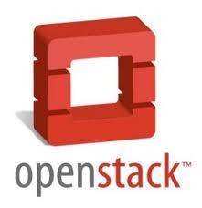
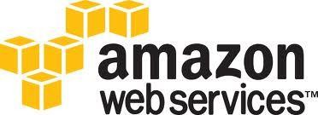
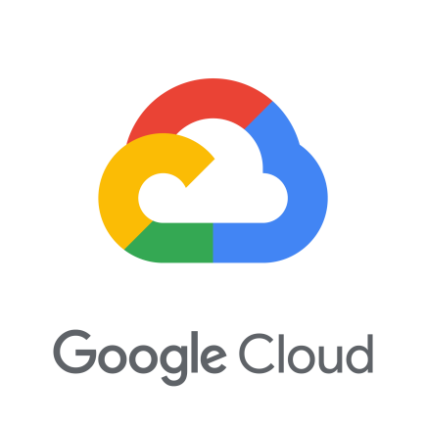

Cloud Deployment Models (NIST)
Public cloud
  Sold to the public, mega- scale infrastructure
  ‘Infinite’ capability
  Metered usage
Private cloud
  Enterprise owned or leased
  Tight security control
Hybrid cloud
  Composition of public and private clouds

Slide 54
Contents
Virtualisation
Datacentres
Cloud Computing drivers
Cloud Computing

Slide 55
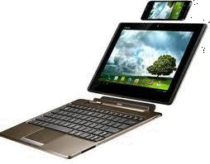
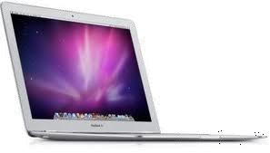
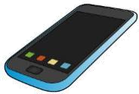
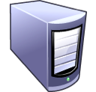



What is NOW Cloud Computing?
Ubiquitous services
  “The Cloud”
  Utility computing model
    IaaS, Paas, *aaS
    Computing in the cloud
Virtualisation
  Elasticity, scalability
  Datacentre 2.0, 3.0: Custom HW
  Cloud computing infrastructure
Scale
  Massively multi user
  Big data challenges, WSC
  Scalability, reliability, resilience
  Cloud applications
Process Component
Business Object
Service Interface

Slide 56











Cloud-based applications
REST SERVICES
Serverless
RESTRSEERSVTICES
Services
Event Processing
Batch Data Processing
Dataflow Languages

Slide 57
“Cloud applications” components
“Services”(REST). Accessed by millions of devices (smartphones, tablets, PCs?)…
RPC, mostly consumer-based
  Traffic varies wildly… agile scalability
  Replication, load balancing, caches, state management
  CDNs have similar requirements
Data acquisition services
  Real time requirements
  Scalability, reliability challenges
Data processing services.
  Huge amounts of data // millions of devices
  Parallel computing languages
  Dataflow languages
  Scalability, reliability
Data storage
  Scalability -> Partitioning
  Data interoperability, Merging

Slide 58
Mobile Interactive Applications
Mobile Services which rely on large data centres which are most conveniently stored in large data centres
Additionally, it is desirable to limit the computation carried out on a mobile device to maximise battery life
Google Maps is a good example of this

Slide 59
Parallel batch processing
Batch processing and analytics jobs can analyse terabytes of data and take hours to finish
If there is enough parallelism, users can use hundreds of servers to complete the job quickly
Tools such as Hadoop can be used to reduce the complexity of implementing these jobs

Slide 60
Extension of compute-intensive desktop applications
The latest versions of mathematics software package Matlab and Mathematica are capable of using Cloud Computing to perform expensive evaluations
Other applications could benefit from this provided it is quicker to move data to and from the cloud
3DS Max supports rendering in the cloud

